Slide 1


<Martin Ng>
<16/6/2024>

Slide 2

Outline
Executive Summary
Introduction
Methodology
Results
Conclusion

Slide 3
Executive Summary
In this capstone project, we aim to predict the successful landing of the SpaceX Falcon 9 first stage using various machine learning classification algorithms.
The key steps involved in this project are:
Collecting, processing, and formatting the data
Conducting exploratory data analysis
Creating interactive data visualizations
Applying machine learning techniques for prediction
Our analyses reveal that certain features of the rocket launches are correlated with the outcome, whether it’s a successful or failed landing.
Based on the findings, the decision tree algorithm appears to be the most suitable machine learning model for predicting the successful landing of the Falcon 9 first stage.

Slide 4
Introduction
In this capstone project, we aim to predict whether the Falcon 9 first stage will land successfully. This is an important consideration, as SpaceX advertises Falcon 9 rocket launches on its website at a cost of $62 million, while other providers charge upwards of $165 million per launch. A significant portion of the savings is due to SpaceX's ability to reuse the first stage. Therefore, by accurately predicting the success of the first stage landing, we can estimate the true cost of a Falcon 9 launch.
This information could be valuable for other companies that want to bid against SpaceX for rocket launch contracts. It's worth noting that most unsuccessful landings by SpaceX are actually planned, as the company sometimes performs controlled landings in the ocean.
The main question we are trying to answer in this project is: Given a set of features about a Falcon 9 rocket launch, such as payload mass, orbit type, launch site, and so on, can we accurately predict whether the first stage of the rocket will land successfully?

Slide 5

Section 1

Slide 6
Methodology
Executive Summary
Data collection and wrangling using SpaceX API and Web scraping
Perform exploratory data analysis (EDA) using visualization and SQL
Perform interactive visual analytics using Folium and Plotly Dash
Perform predictive analysis using classification models
Logistic Regression
Support Vector Machine
Decision Tree
K-nearest Neighbors

Slide 7
Data Collection and Wrangling
The dataset was subsequently processed to address any missing data points. Additionally, the categorical features were encoded using the one-hot encoding technique.
Furthermore, a new column named 'Class' was added to the dataset. This column indicates whether a given launch was successful (denoted by '1') or failed (denoted by '0’).
Finally, the final dataset comprises 90 rows (or instances) and 83 columns (or features).

Slide 8
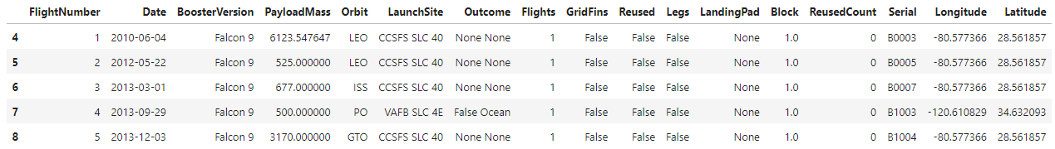
Data Collection – SpaceX API
SpaceX API provides numerous types of rocket launches by SpaceX.
Data is filtered to contain only Falcon 9 launches
All missing values in the data were replaced with the mean value of the corresponding column
The final dataset contains 90 rows and 17 columns. The image below shows the first 5 rows of the dataset

Slide 9
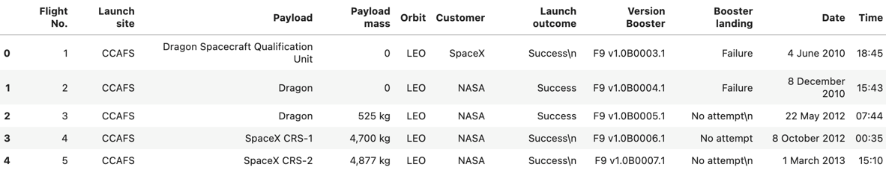
Data Collection - Scraping
The website contains the data of Falcon 9 launches
The final dataset contains 121 rows and 11 columns. The image below shows the first 5 rows of the dataset:

Slide 10
EDA with Data Visualization
Pandas and Numpy
To derive basic insights about the collected dataset, functions from the Pandas and NumPy libraries were utilized. This analysis included:
Determining the number of launches from each launch site
Identifying the frequency of occurrence for each type of orbit
Calculating the number and occurrence of each mission outcome (i.e., successful or failed launches).
Matplotlib and Seaborn
To further explore the data, functions from the Matplotlib and Seaborn data visualization libraries were utilized. This allowed the creation of scatterplots, bar charts, and line charts to visually represent the data. These visualizations were used to investigate the relationships between several features, including:
The relationship between flight number and launch site
The relationship between payload mass and launch site
The relationship between success rate and orbit type

Slide 11
EDA with SQL
The space mission data is analyzed using SQL queries to extract and provide answers to various questions, including:
Identifying the distinct launch sites where the space missions have taken place.
Calculating the total payload mass that has been carried by boosters launched under the NASA (CRS) program.
Determining the average payload mass carried by the booster version 'F9 v1.1'.
In essence, the SQL queries are used to explore and gain insights from the space mission data by focusing on aspects such as launch locations, payload capacities for specific agencies, and performance characteristics of different booster versions.
The goal is to leverage the data and extract valuable information to better understand and analyze the space missions through these targeted SQL-based queries.

Slide 12
Build an Interactive Map with Folium
The Folium library is utilized to create interactive visualizations of the space mission data through the use of maps. Specifically, the Folium library is employed to:
Plot all the launch sites on a map, providing a spatial representation of where the space missions have originated.
Distinguish between the successful and failed launches for each launch site on the interactive map, allowing for a clear visual differentiation of the mission outcomes.
Indicate the distances between each launch site and its closest proximity, such as the nearest city, railway, or highway. This added contextual information helps to better understand the geographic landscape and accessibility of the launch locations.
In summary, the Folium library enables the creation of dynamic, map-based visualizations that help to spatially represent and analyze various aspects of the space mission data, including launch site locations, mission success rates, and the surrounding infrastructure and geography.

Slide 13
Build a Dashboard with Plotly Dash
The interactive site built using Dash allows users to toggle inputs via a dropdown menu and range slider. This site presents:
A pie chart showing the total successful launches from each launch site.
A scatterplot illustrating the correlation between payload mass and mission outcome (success or failure) for each launch site.
The Dash-powered interface enables users to dynamically explore the space mission data, with the visualizations reflecting changes to the input parameters.

Slide 14
Predictive Analysis (Classification)
The Scikit-learn library is used to create machine learning models for the space mission data. The machine learning prediction process includes:
Standardizing the data
Splitting the data into training and test sets
Creating machine learning models, including:
Logistic regression
Support vector machine (SVM)
Decision tree
K-nearest neighbors (KNN)
Training the models on the training data
Tuning the hyperparameters to find the best-performing models
Evaluating the models based on accuracy scores and confusion matrices
The Scikit-learn library provides the necessary functions and tools to perform this end-to-end machine learning workflow on the space mission data.

Slide 15

Section 2

Slide 16
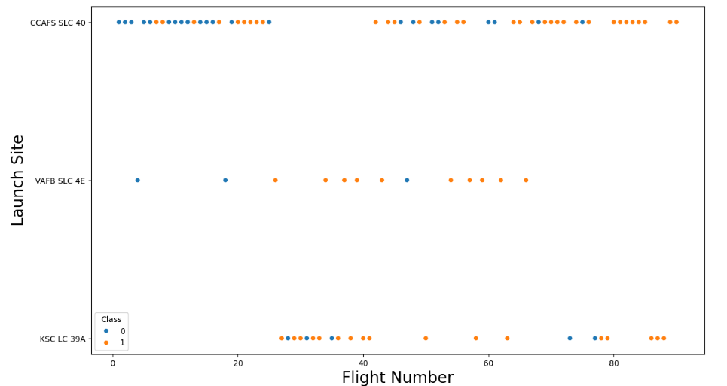
Flight Number vs. Launch Site

Slide 17
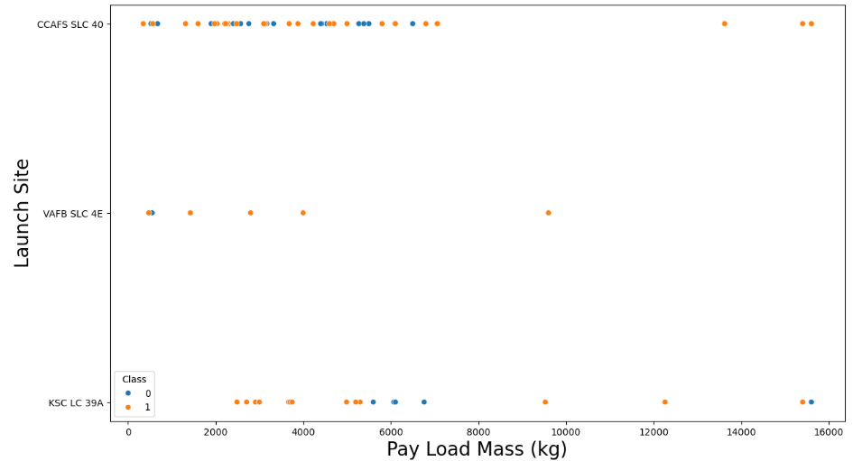
Payload vs. Launch Site

Slide 18
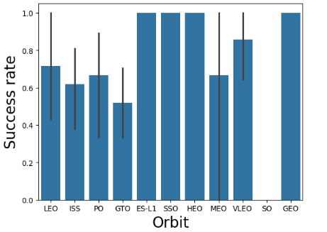
Success Rate vs. Orbit Type

Slide 19
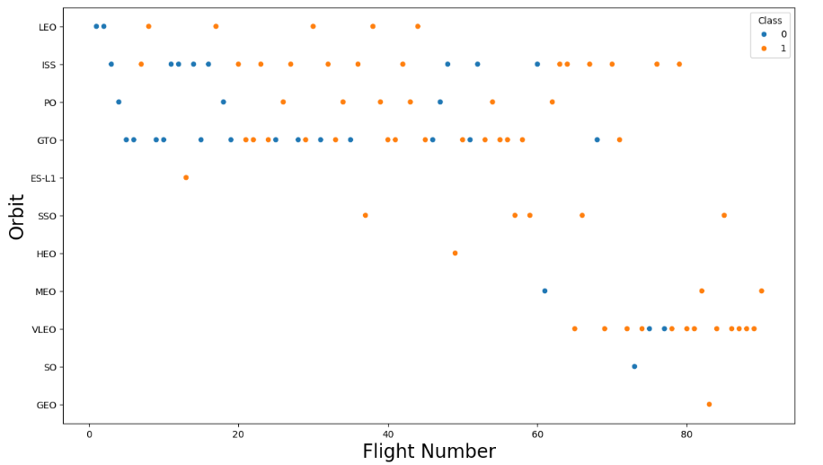
Flight Number vs. Orbit Type

Slide 20
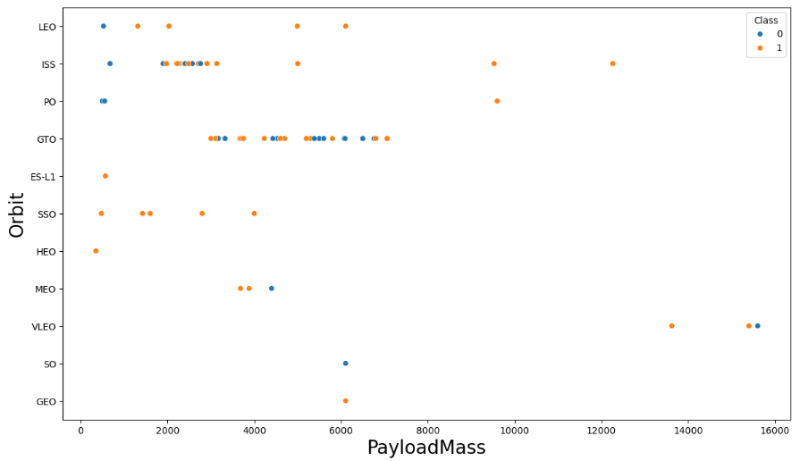
Payload vs. Orbit Type

Slide 21
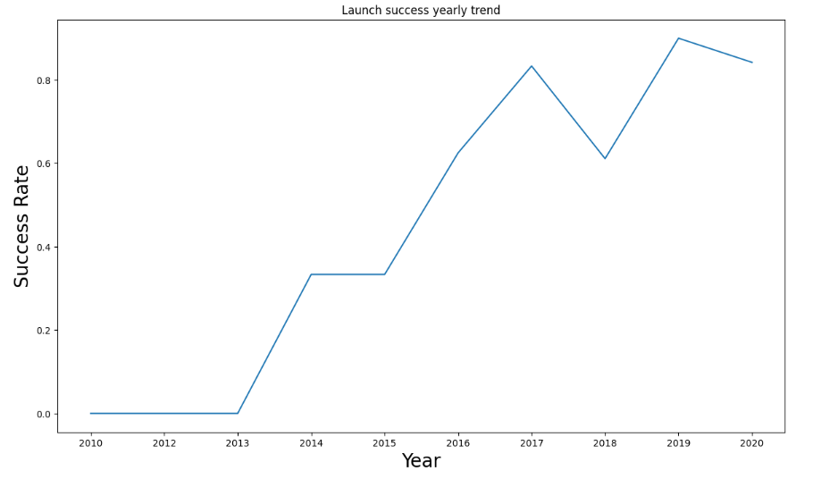
Launch Success Yearly Trend

Slide 22
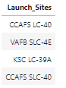
All Launch Site Names

Slide 23
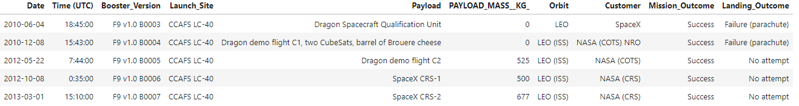
Launch Site Names Begin with 'CCA'

Slide 24
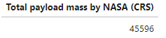
Total Payload Mass

Slide 25
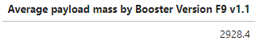
Average Payload Mass by F9 v1.1

Slide 26

First Successful Ground Landing Date

Slide 27
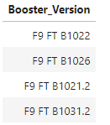
Successful Drone Ship Landing with Payload between 4000 and 6000

Slide 28
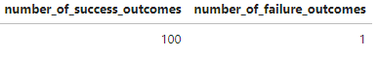
Total Number of Successful and Failure Mission Outcomes

Slide 29
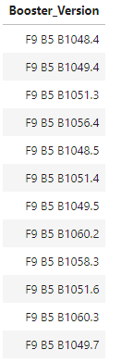
Boosters Carried Maximum Payload

Slide 30
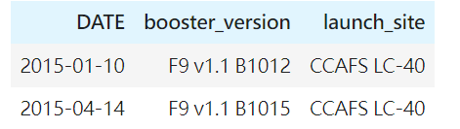
2015 Launch Records

Slide 31
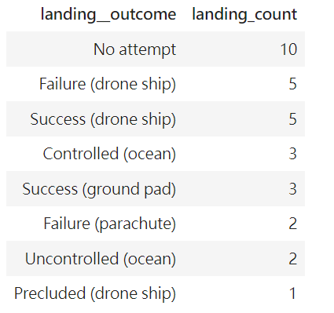
Rank Landing Outcomes Between 2010-06-04 and 2017-03-20

Slide 32

Section 3

Slide 33
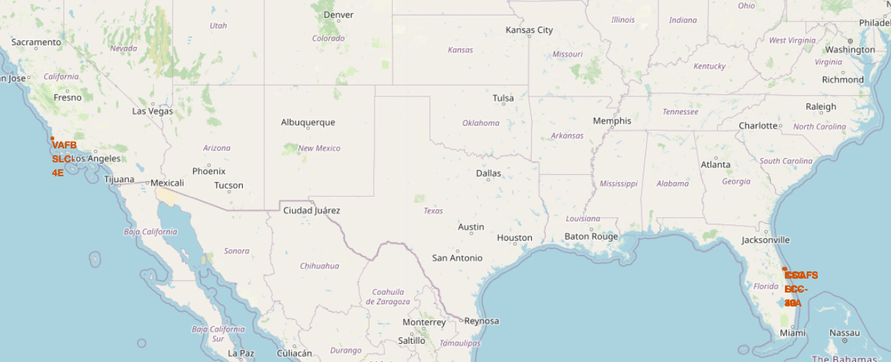
Launch Sites Location

Slide 34
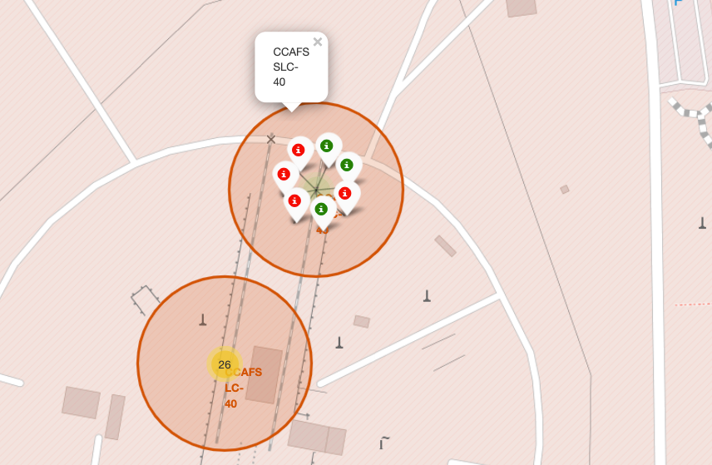
Launch Outcomes on Map
Green tags represent successful launches while red tags represent failed Launches.

Slide 35
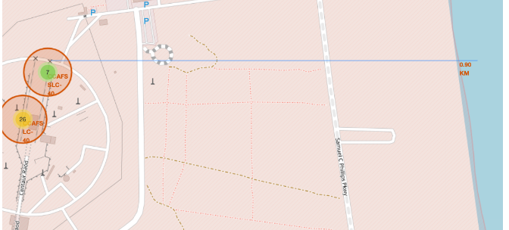
Distance Between a Launch Site to Proximities

Slide 36

Section 4

Slide 37
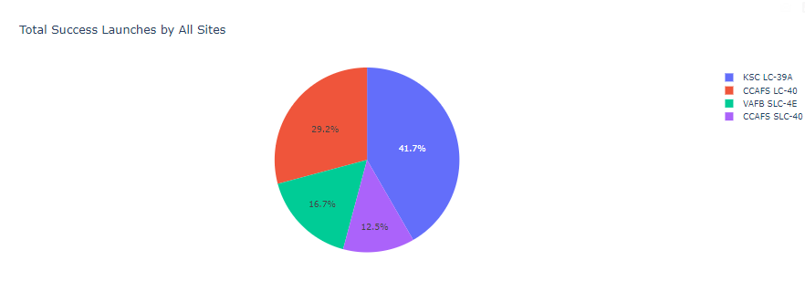
Total Success Launches by All Sites

Slide 38
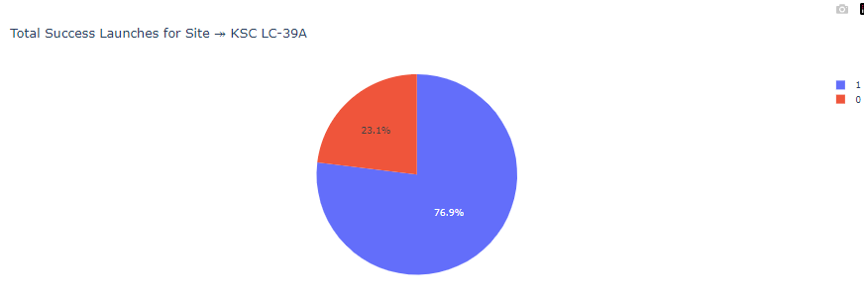
Launch Site with Highest Launch Success Ratio
KSC LC-39A is the launch site with the highest launch success ratio.
0 represents failed launches while 1 represents successful launches.

Slide 39
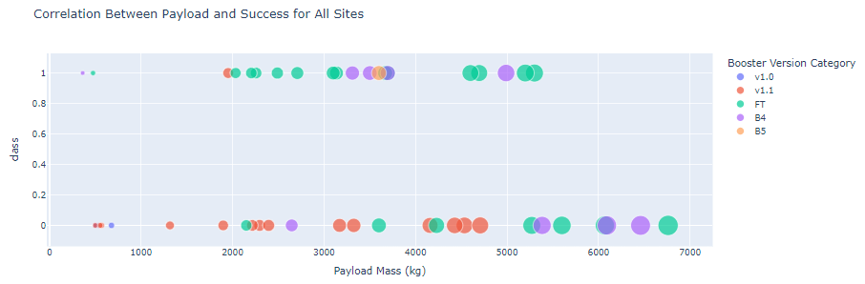
Correlation Between Payload and Success for All sites

Slide 40

Section 5

Slide 41
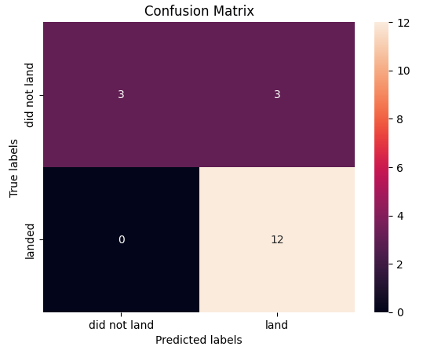
Logistic Regression
GridSearchCV best scores: 0.8464
Accuracy score: 0.8333
Confusion Matric:

Slide 42
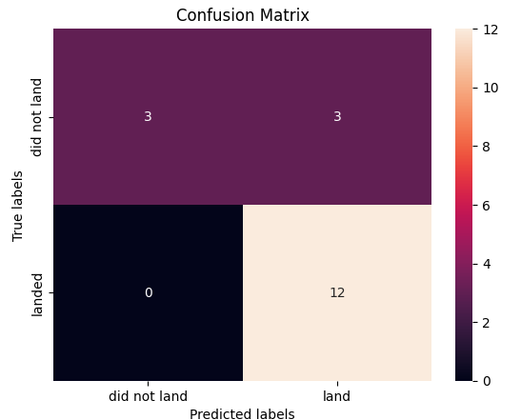
Support Vector Machine (SVM)
GridSearchCV best scores: 0.8482
Accuracy score: 0.8333
Confusion Matric:

Slide 43

Decision Tree
GridSearchCV best scores: 0.8643
Accuracy score: 0.6667
Confusion Matric:

Slide 44

K-nearest Neighbors (KNN)
GridSearchCV best scores: 0.8482
Accuracy score: 0.8333
Confusion Matric:

Slide 45
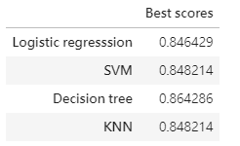
Result
Based on the GridSearchCV best score, decision tree would be the most appropriate model to be used in this case.

Slide 46
Conclusions
In this project, we aim to predict whether the first stage of a Falcon 9 launch will successfully land, in order to determine the cost of the launch.
Each feature of a Falcon 9 launch, such as its payload mass or orbit type, may have a specific impact on the mission outcome.
Multiple machine learning algorithms are used to learn the patterns from past Falcon 9 launch data, in order to create predictive models that can forecast the outcome of future Falcon 9 launches.
Of the four machine learning algorithms employed, the predictive model generated by the decision tree algorithm demonstrated the best performance.

Slide 47


